Slide 1
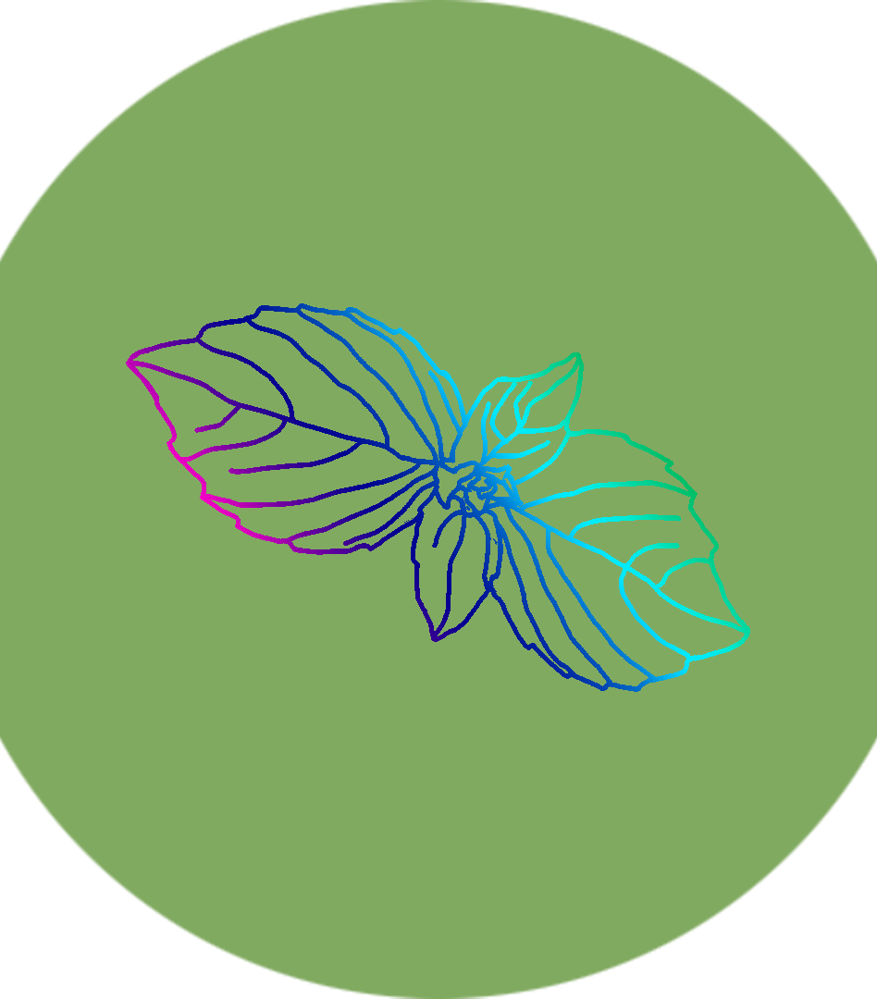
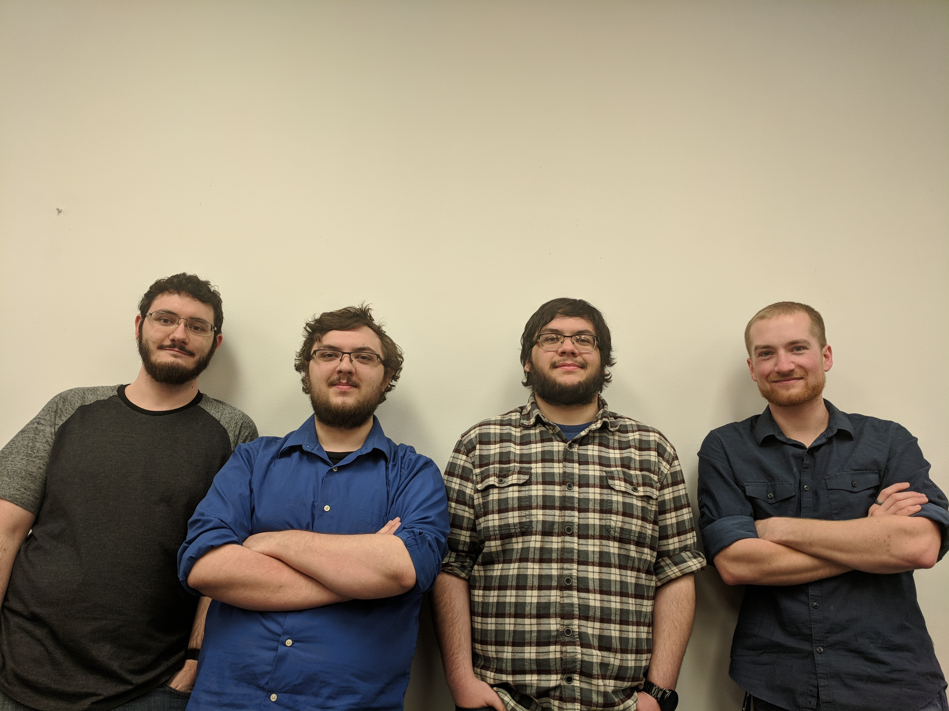
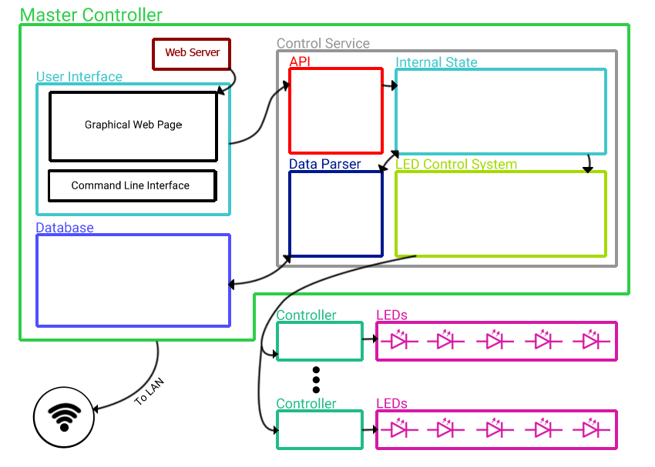
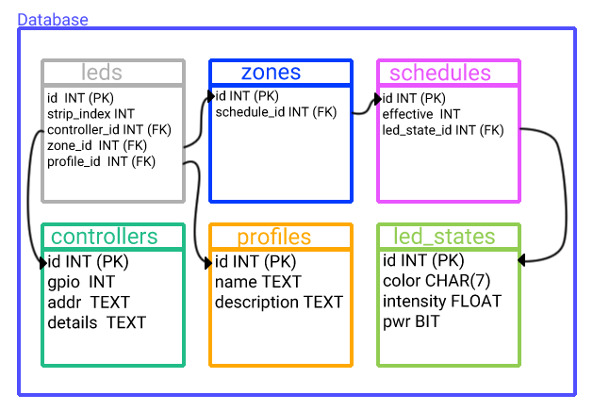
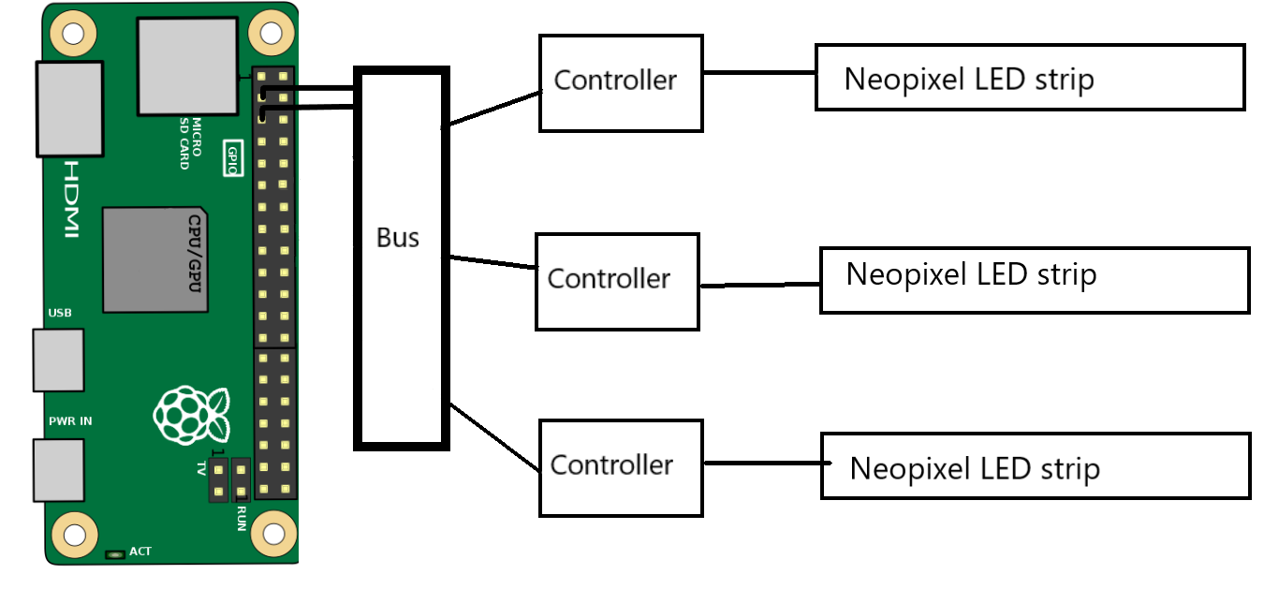
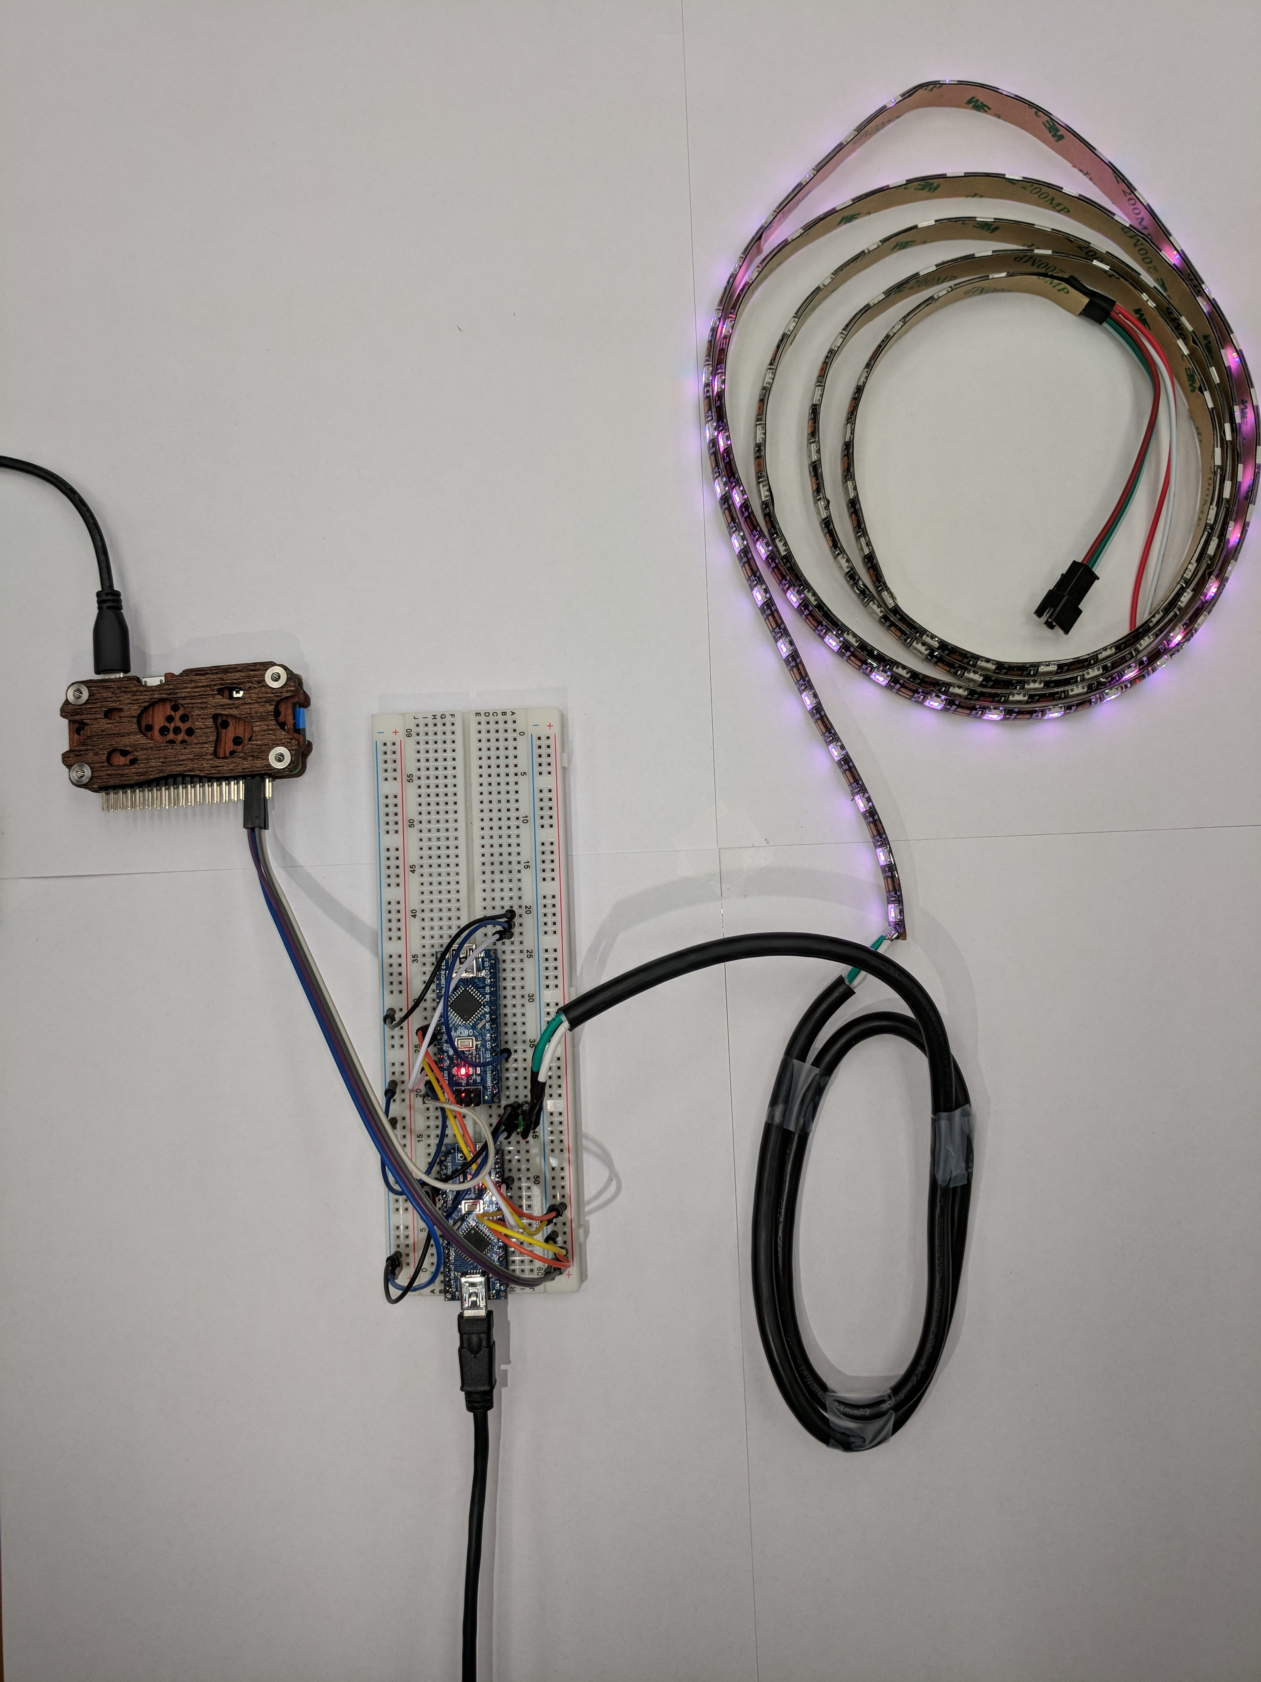
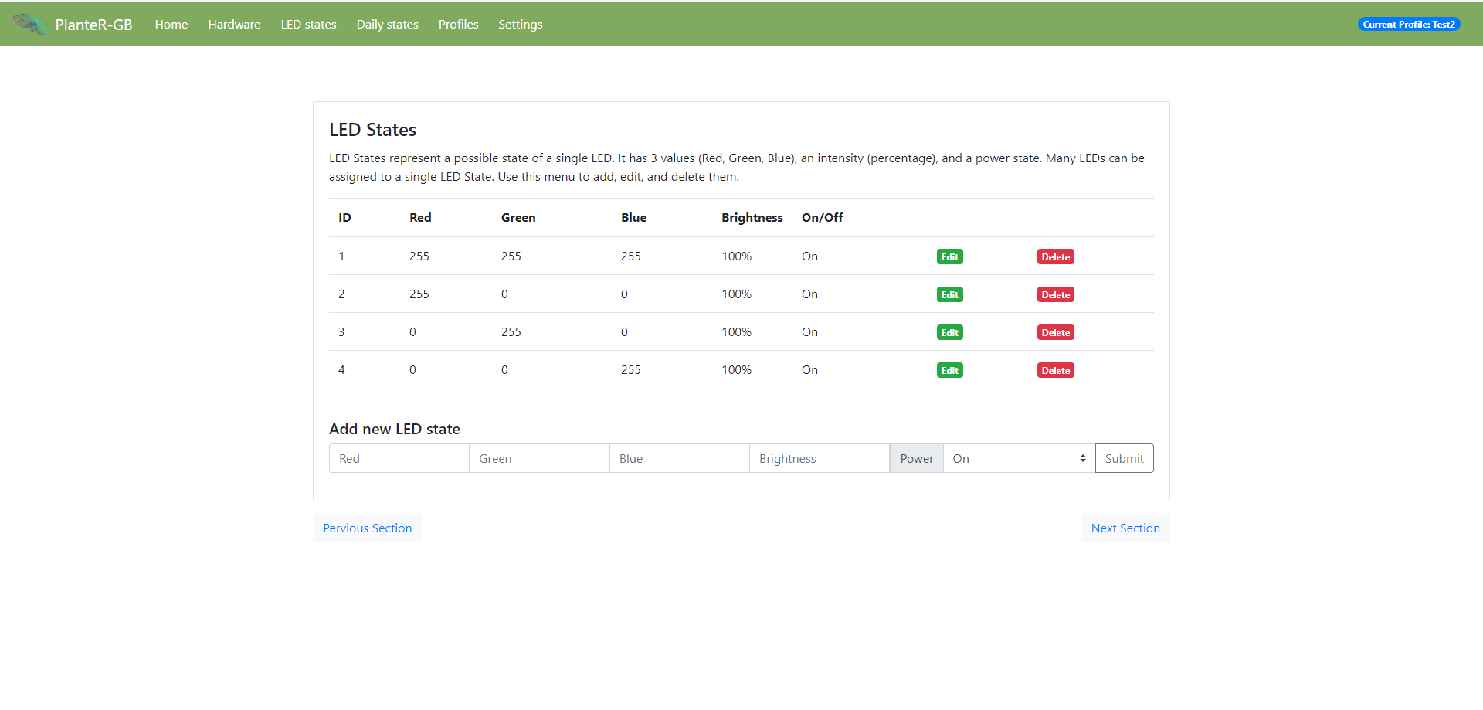
CS64
Introduction
Winter is coming….
During cold and dark winters, growing outside can be difficult. In Oregon we are well accustomed to low temperatures and rain for most of the year. Many plants and herbs such as tomatoes, basil, and plants from foreign climates do not grow well in Oregon conditions.
To fix this problem, many growers have started small indoor grow systems. This allows them to have more consistent lighting, while also keeping the plants out of the cold.
One issue with these lighting systems is the color range. These systems generally only consist of one color such as white or pink. Another issue is scheduling. Most systems do not include a way to schedule when lights turn on, or off, the color or the intensity. This creates a conflict between optimal lighting conditions for the plant, and the user.
PlanteR-GB: An RGB lighting system for indoor plant growth.
From left to right: Zach Lerew, Austin Hodgin, Travis Hodgin, Max Schmidt
Project description
An RGB plant lighting system
LEDS controlled by an Arduino Nano
Raspberry Pi Zero W as the control system implements:
API: RESTful communication interface between the internal state and the user interface.
Internal State: Virtual representation of the full system.
User Interface: Python script/Nodejs based web page for interacting with the system
State Composer: Systematic translation of the virtual state onto the hardware.
Database storage: persistent storage of internal state
Hardware: Physical components that reflect the state given by the system
Hardware Used:
Arduino Nano
Raspberry Pi Zero W
WS2812 Neopixel LEDs
Fig 1: Internal System Diagram
The Team
Victor Hsu: Project sponsor. Provided us with hardware. Loves fresh herbs and spices. hsuv@oregonstate.edu
Austin Hodgin: Expo Captain. CLI, Site. austin.hodgin@oregonstate.edu
Travis Hodgin: WebDev Hero. Website, LED controller firmware. hodgint@oregonstate.edu
Max Schmidt: Hardware Guru. State composer, power system. schmidtm@oregonstate.edu
Zach Lerew: Project lead. API, internal state, database management system. lerewz@oregonstate.edu
Fig 2: Diagram of Hardware
Fig 3: Hardware Setup
Fig 4: Site based LED state control

